Slide 1
Module 4: EtherChannel and HSRP
Switching, Routing and Wireless Essentials v7.0 (SRWE)
Notes:
Cisco Networking Academy Program Switching, Routing and Wireless Essentials v7.0 (SRWE)
Module 6: EtherChannel

Slide 2
Module Objectives
Module Title: EtherChannel and HSRP
Module Objective: Troubleshoot EtherChannel on switched links.
Explain how HSRP provide default gateway services in a redundant network.
Topic Title | Topic Objective
EtherChannel Operation | Describe EtherChannel technology.
Configure EtherChannel | Configure EtherChannel.
Verify and Troubleshoot EtherChannel | Troubleshoot EtherChannel.
First Hop Redundancy Protocols | Explain the purpose and operation of first hop redundancy protocols.
HSRP | Explain how HSRP operates.
Notes:
2
6.0 – Introduction
6.0.2 – What will I learn in this module?

Slide 3
4.1 EtherChannel Operation
Notes:
6- Basic Device Configuration
6.1 – EtherChannel Operation

Slide 4
EtherChannel Operation Link Aggregation
There are scenarios in which more bandwidth or redundancy between devices is needed than what can be provided by a single link. Multiple links could be connected between devices to increase bandwidth. However, Spanning Tree Protocol (STP), which is enabled on Layer 2 devices like Cisco switches by default, will block redundant links to prevent switching loops.
A link aggregation technology is needed that allows redundant links between devices that will not be blocked by STP. That technology is known as EtherChannel.
EtherChannel is a link aggregation technology that groups multiple physical Ethernet links together into one single logical link. It is used to provide fault-tolerance, load sharing, increased bandwidth, and redundancy between switches, routers, and servers.
EtherChannel technology makes it possible to combine the number of physical links between the switches to increase the overall speed of switch-to-switch communication.
Notes:
6 – EtherChannel
6.1 – EtherChannel Operation
6.1.1 – Link Aggregation

Slide 5
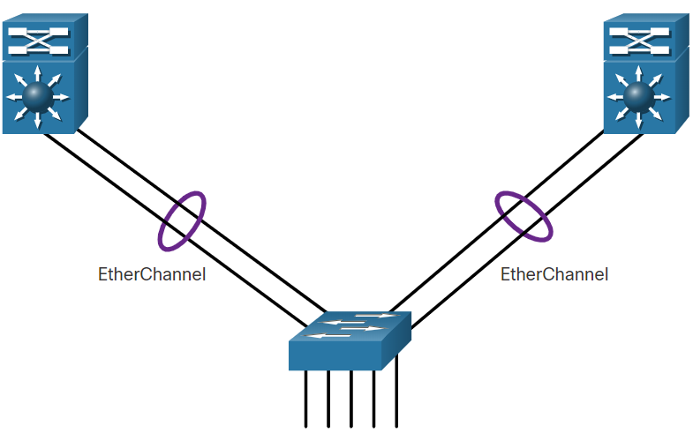
EtherChannel Operation EtherChannel
EtherChannel technology was originally developed by Cisco as a LAN switch-to-switch technique of grouping several Fast Ethernet or Gigabit Ethernet ports into one logical channel.
When an EtherChannel is configured, the resulting virtual interface is called a port channel. The physical interfaces are bundled together into a port channel interface, as shown in the figure.
Notes:
6 – EtherChannel
6.1 – EtherChannel Operation
6.1.2 - EtherChannel

Slide 6
EtherChannel Operation Advantages of EtherChannel
EtherChannel technology has many advantages, including the following:
Most configuration tasks can be done on the EtherChannel interface instead of on each individual port, ensuring configuration consistency throughout the links.
EtherChannel relies on existing switch ports. There is no need to upgrade the link to a faster and more expensive connection to have more bandwidth.
Load balancing takes place between links that are part of the same EtherChannel.
EtherChannel creates an aggregation that is seen as one logical link. When several EtherChannel bundles exist between two switches, STP may block one of the bundles to prevent switching loops. When STP blocks one of the redundant links, it blocks the entire EtherChannel. This blocks all the ports belonging to that EtherChannel link. Where there is only one EtherChannel link, all physical links in the EtherChannel are active because STP sees only one (logical) link.
EtherChannel provides redundancy because the overall link is seen as one logical connection. Additionally, the loss of one physical link within the channel does not create a change in the topology.
Notes:
6 – EtherChannel
6.1 – EtherChannel Operation
6.1.3 – Advantages of EtherChannel

Slide 7
EtherChannel Operation Implementation Restrictions
EtherChannel has certain implementation restrictions, including the following:
Interface types cannot be mixed. For example, Fast Ethernet and Gigabit Ethernet cannot be mixed within a single EtherChannel.
Currently each EtherChannel can consist of up to eight compatibly-configured Ethernet ports. EtherChannel provides full-duplex bandwidth up to 800 Mbps (Fast EtherChannel) or 8 Gbps (Gigabit EtherChannel) between one switch and another switch or host.
The Cisco Catalyst 2960 Layer 2 switch currently supports up to six EtherChannels.
The individual EtherChannel group member port configuration must be consistent on both devices. If the physical ports of one side are configured as trunks, the physical ports of the other side must also be configured as trunks within the same native VLAN. Additionally, all ports in each EtherChannel link must be configured as Layer 2 ports.
Each EtherChannel has a logical port channel interface. A configuration applied to the port channel interface affects all physical interfaces that are assigned to that interface.
Notes:
6 – EtherChannel
6.1 – EtherChannel Operation
6.1.4 – Implementation Restrictions

Slide 8
EtherChannel Operation AutoNegotiation Protocols
EtherChannels can be formed through negotiation using one of two protocols, Port Aggregation Protocol (PAgP) or Link Aggregation Control Protocol (LACP). These protocols allow ports with similar characteristics to form a channel through dynamic negotiation with adjoining switches.
Note: It is also possible to configure a static or unconditional EtherChannel without PAgP or LACP.
Notes:
6 – EtherChannel
6.1 – EtherChannel Operation
6.1.5 – AutoNegotiation Protocols

Slide 9
EtherChannel Operation PAgP Operation
PAgP (pronounced “Pag - P”) is a Cisco-proprietary protocol that aids in the automatic creation of EtherChannel links. When an EtherChannel link is configured using PAgP, PAgP packets are sent between EtherChannel-capable ports to negotiate the forming of a channel. When PAgP identifies matched Ethernet links, it groups the links into an EtherChannel. The EtherChannel is then added to the spanning tree as a single port.
When enabled, PAgP also manages the EtherChannel. PAgP packets are sent every 30 seconds. PAgP checks for configuration consistency and manages link additions and failures between two switches. It ensures that when an EtherChannel is created, all ports have the same type of configuration.
Note: In EtherChannel, it is mandatory that all ports have the same speed, duplex setting, and VLAN information. Any port modification after the creation of the channel also changes all other channel ports.
Notes:
6 – EtherChannel
6.1 – EtherChannel Operation
6.1.6 – PAgP Operation

Slide 10
EtherChannel Operation PAgP Operation (Cont.)
PAgP helps create the EtherChannel link by detecting the configuration of each side and ensuring that links are compatible so that the EtherChannel link can be enabled when needed. The modes for PAgP as follows:
On - This mode forces the interface to channel without PAgP. Interfaces configured in the on mode do not exchange PAgP packets.
PAgP desirable - This PAgP mode places an interface in an active negotiating state in which the interface initiates negotiations with other interfaces by sending PAgP packets.
PAgP auto - This PAgP mode places an interface in a passive negotiating state in which the interface responds to the PAgP packets that it receives but does not initiate PAgP negotiation.
The modes must be compatible on each side. If one side is configured to be in auto mode, it is placed in a passive state, waiting for the other side to initiate the EtherChannel negotiation. If the other side is also set to auto, the negotiation never starts and the EtherChannel does not form. If all modes are disabled by using the no command, or if no mode is configured, then the EtherChannel is disabled. The on mode manually places the interface in an EtherChannel, without any negotiation. It works only if the other side is also set to on. If the other side is set to negotiate parameters through PAgP, no EtherChannel forms, because the side that is set to on mode does not negotiate. No negotiation between the two switches means there is no checking to make sure that all the links in the EtherChannel are terminating on the other side, or that there is PAgP compatibility on the other switch.
Notes:
6 – EtherChannel
6.1 – EtherChannel Operation
6.1.6 – PAgP Operation (Cont.)

Slide 11
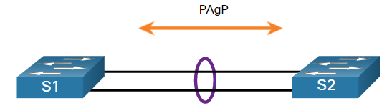
EtherChannel Operation PAgP Mode Settings Example
The table shows the various combination of PAgP modes on S1 and S2 and the resulting channel establishment outcome.
S1 | S2 | Channel Establishment
On | On | Yes
On | Desirable/Auto | No
Desirable | Desirable | Yes
Desirable | Auto | Yes
Auto | Desirable | Yes
Auto | Auto | No
Notes:
6 – EtherChannel
6.1 – EtherChannel Operation
6.1.7 – PAgP Mode Settings Example

Slide 12
EtherChannel Operation LACP Operation
LACP is part of an IEEE specification (802.3ad) that allows several physical ports to be bundled to form a single logical channel. LACP allows a switch to negotiate an automatic bundle by sending LACP packets to the other switch. It performs a function similar to PAgP with Cisco EtherChannel. Because LACP is an IEEE standard, it can be used to facilitate EtherChannels in multivendor environments. On Cisco devices, both protocols are supported.
LACP provides the same negotiation benefits as PAgP. LACP helps create the EtherChannel link by detecting the configuration of each side and making sure that they are compatible so that the EtherChannel link can be enabled when needed. The modes for LACP are as follows:
On - This mode forces the interface to channel without LACP. Interfaces configured in the on mode do not exchange LACP packets.
LACP active - This LACP mode places a port in an active negotiating state. In this state, the port initiates negotiations with other ports by sending LACP packets.
LACP passive - This LACP mode places a port in a passive negotiating state. In this state, the port responds to the LACP packets that it receives but does not initiate LACP packet negotiation.
Notes:
6 – EtherChannel
6.1 – EtherChannel Operation
6.1.8 – LACP Operation

Slide 13
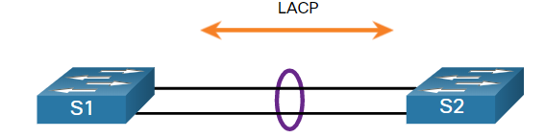
EtherChannel Operation LACP Mode Settings Example
The table shows the various combination of LACP modes on S1 and S2 and the resulting channel establishment outcome.
S1 | S2 | Channel Establishment
On | On | Yes
On | Active/Passive | No
Active | Active | Yes
Active | Passive | Yes
Passive | Active | Yes
Passive | Passive | No
Notes:
6 – EtherChannel
6.1 – EtherChannel Operation
6.1.9 – LACP Mode Settings Example
6.1.10 – Check Your Understanding – EtherChannel Operation

Slide 14
4.2 Configure EtherChannel
Notes:
6- Basic Device Configuration
6.2 – Configure EtherChannel

Slide 15
Configure EtherChannel Configuration Guidelines
The following guidelines and restrictions are useful for configuring EtherChannel:
EtherChannel support - All Ethernet interfaces must support EtherChannel with no requirement that interfaces be physically contiguous.
Speed and duplex - Configure all interfaces in an EtherChannel to operate at the same speed and in the same duplex mode.
VLAN match - All interfaces in the EtherChannel bundle must be assigned to the same VLAN or be configured as a trunk (shown in the figure).
Range of VLANs - An EtherChannel supports the same allowed range of VLANs on all the interfaces in a trunking EtherChannel. If the allowed range of VLANs is not the same, the interfaces do not form an EtherChannel, even when they are set to auto or desirable mode.
Notes:
6 – EtherChannel
6.2 – Configure EtherChannel
6.2.1 – Configuration Guidelines

Slide 16
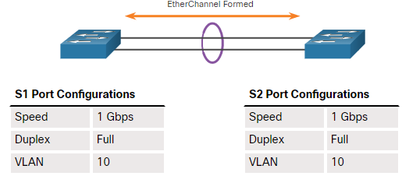
Configure EtherChannel Configuration Guidelines (Cont.)
The figure shows a configuration that would allow an EtherChannel to form between S1 and S2.
If these settings must be changed, configure them in port channel interface configuration mode. Any configuration that is applied to the port channel interface also affects individual interfaces. However, configurations that are applied to the individual interfaces do not affect the port channel interface. Therefore, making configuration changes to an interface that is part of an EtherChannel link may cause interface compatibility issues.
The port channel can be configured in access mode, trunk mode (most common), or on a routed port.
Notes:
6 – EtherChannel
6.2 – Configure EtherChannel
6.2.1 – Configuration Guidelines (Cont.)

Slide 17
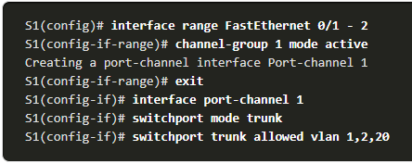
Configure EtherChannel LACP Configuration Example
Configuring EtherChannel with LACP requires the following three steps:
Step 1. Specify the interfaces that compose the EtherChannel group using the interface range interface global configuration mode command. The range keyword allows you to select several interfaces and configure them all together.
Step 2. Create the port channel interface with the channel-group identifier mode active command in interface range configuration mode. The identifier specifies a channel group number. The mode active keywords identify this as an LACP EtherChannel configuration.
Step3. To change Layer 2 settings on the port channel interface, enter port channel interface configuration mode using the interface port-channel command, followed by the interface identifier. In the example, S1 is configured with an LACP EtherChannel. The port channel is configured as a trunk interface with the allowed VLANs specified.
Notes:
6 – EtherChannel
6.2 – Configure EtherChannel
6.2.2 – LACP Configuration Example
6.2.3 – Syntax Checker – Configure EtherChannel

Slide 18
4.3 Verify and Troubleshoot EtherChannel
Notes:
6- Basic Device Configuration
6.3 – Verify and Troubleshoot EtherChannel

Slide 19
Verify and Troubleshoot EtherChannel Verify EtherChannel
As always, when you configure devices in your network, you must verify your configuration. If there are problems, you will also need to be able to troubleshoot and fix them. There are a number of commands to verify an EtherChannel configuration:
The show interfaces port-channel command displays the general status of the port channel interface.
The show etherchannel summary command displays one line of information per port channel.
The show etherchannel port-channel command displays information about a specific port channel interface.
The show interfaces etherchannel command can provide information about the role of a physical member interface of the EtherChannel.
Notes:
6 – EtherChannel
6.3 – Verify and Troubleshoot EtherChannel
6.3.1 – Verify EtherChannel

Slide 20
Verify and Troubleshoot EtherChannel Common Issues with EtherChannel Configurations
All interfaces within an EtherChannel must have the same configuration of speed and duplex mode, native and allowed VLANs on trunks, and access VLAN on access ports. Ensuring these configurations will significantly reduce network problems related to EtherChannel. Common EtherChannel issues include the following:
Assigned ports in the EtherChannel are not part of the same VLAN, or not configured as trunks. Ports with different native VLANs cannot form an EtherChannel.
Trunking was configured on some of the ports that make up the EtherChannel, but not all of them. It is not recommended that you configure trunking mode on individual ports that make up the EtherChannel. When configuring a trunk on an EtherChannel, verify the trunking mode on the EtherChannel.
If the allowed range of VLANs is not the same, the ports do not form an EtherChannel even when PAgP is set to the auto or desirable mode.
The dynamic negotiation options for PAgP and LACP are not compatibly configured on both ends of the EtherChannel.
Notes:
6 – EtherChannel
6.3 – Verify and Troubleshoot EtherChannel
6.3.2 – Common Issues with EtherChannel Configurations

Slide 21

Verify and Troubleshoot EtherChannel Troubleshoot EtherChannel Example
In the figure, interfaces F0/1 and F0/2 on switches S1 and S2 are connected with an EtherChannel. However, the EtherChannel is not operational.
Notes:
6 – EtherChannel
6.3 – Verify and Troubleshoot EtherChannel
6.3.3 – Troubleshoot EtherChannel Example

Slide 22
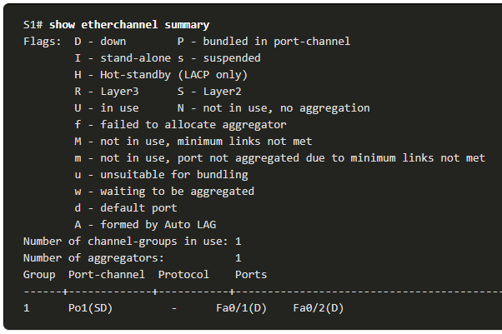
Verify and Troubleshoot EtherChannel Troubleshoot EtherChannel Example (Cont.)
Step 1. View the EtherChannel Summary Information: The output of the show etherchannel summary command indicates that the EtherChannel is down.
Notes:
6 – EtherChannel
6.3 – Verify and Troubleshoot EtherChannel
6.3.3 – Troubleshoot EtherChannel Example (Cont.)

Slide 23
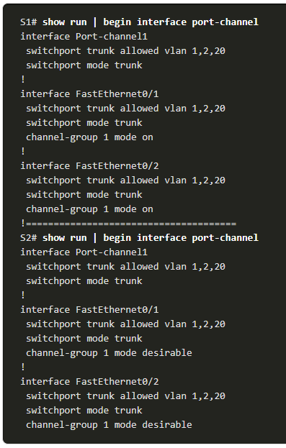
Verify and Troubleshoot EtherChannel Troubleshoot EtherChannel Example (Cont.)
Step 2. View Port Channel Configuration: In the show run | begin interface port-channel output, more detailed output indicates that there are incompatible PAgP modes configured on S1 and S2.
Notes:
6 – EtherChannel
6.3 – Verify and Troubleshoot EtherChannel
6.3.3 – Troubleshoot EtherChannel Example (Cont.)

Slide 24
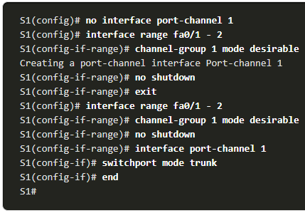
Verify and Troubleshoot EtherChannel Troubleshoot EtherChannel Example (Cont.)
Step 3: Correct the Misconfiguration: To correct the issue, the PAgP mode on the EtherChannel is changed to desirable.
Note: EtherChannel and STP must interoperate. For this reason, the order in which EtherChannel-related commands are entered is important, which is why you see interface Port-Channel 1 removed and then re-added with the channel-group command, as opposed to directly changed. If one tries to change the configuration directly, STP errors cause the associated ports to go into blocking or errdisabled state.
Notes:
6 – EtherChannel
6.3 – Verify and Troubleshoot EtherChannel
6.3.3 – Troubleshoot EtherChannel Example (Cont.)

Slide 25
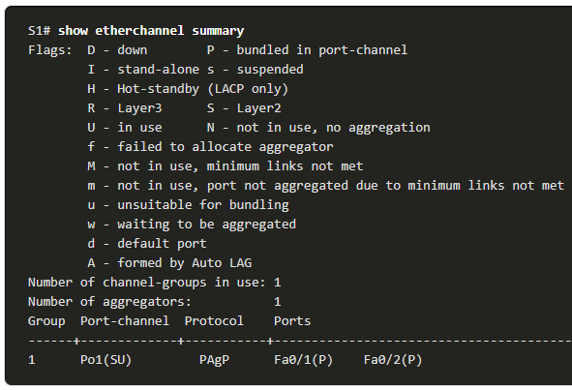
Verify and Troubleshoot EtherChannel Troubleshoot EtherChannel Example (Cont.)
Step 4. Verify EtherChannel is Operational: The EtherChannel is now active as verified by the output of the show etherchannel summary command.
Notes:
6 – EtherChannel
6.3 – Verify and Troubleshoot EtherChannel
6.3.3 – Troubleshoot EtherChannel Example (Cont.)

Slide 26
4.4 First Hop Redundancy Protocols
Notes:
9 – FHRP Concepts
9.1 – First Hop Redundancy Protocols

Slide 27
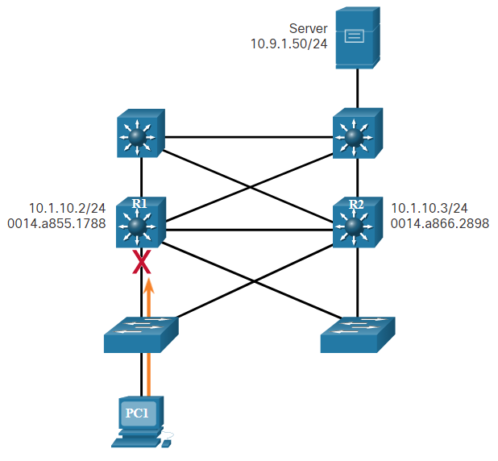
First Hop Redundancy Protocols Default Gateway Limitations
End devices are typically configured with a single default gateway IPv4 address.
If the default gateway router interface fails, LAN hosts lose outside LAN connectivity.
This occurs even if a redundant router or Layer 3 switch that could serve as a default gateway exists.
First hop redundancy protocols (FHRPs) are mechanisms that provide alternate default gateways in switched networks where two or more routers are connected to the same VLANs.
Notes:
9 – FHRP Concepts
9.1 – First Hop Redundancy Protocols
9.1.1 – Default Gateway Limitations

Slide 28
First Hop Redundancy Protocols Router Redundancy
One way to prevent a single point of failure at the default gateway is to implement a virtual router. To implement this type of router redundancy, multiple routers are configured to work together to present the illusion of a single router to the hosts on the LAN. By sharing an IP address and a MAC address, two or more routers can act as a single virtual router.
The IPv4 address of the virtual router is configured as the default gateway for the workstations on a specific IPv4 segment.
When frames are sent from host devices to the default gateway, the hosts use ARP to resolve the MAC address that is associated with the IPv4 address of the default gateway. The ARP resolution returns the MAC address of the virtual router. Frames that are sent to the MAC address of the virtual router can then be physically processed by the currently active router within the virtual router group.
A protocol is used to identify two or more routers as the devices that are responsible for processing frames that are sent to the MAC or IP address of a single virtual router. Host devices send traffic to the address of the virtual router. The physical router that forwards this traffic is transparent to the host devices.
Notes:
9 – FHRP Concepts
9.1 – First Hop Redundancy Protocols
9.1.2 – Router Redundancy

Slide 29
First Hop Redundancy Protocols Router Redundancy (Cont.)
A redundancy protocol provides the mechanism for determining which router should take the active role in forwarding traffic. It also determines when the forwarding role must be taken over by a standby router. The transition from one forwarding router to another is transparent to the end devices.
The ability of a network to dynamically recover from the failure of a device acting as a default gateway is known as first-hop redundancy.
Notes:
9 – FHRP Concepts
9.1 – First Hop Redundancy Protocols
9.1.2 – Router Redundancy (Cont.)

Slide 30
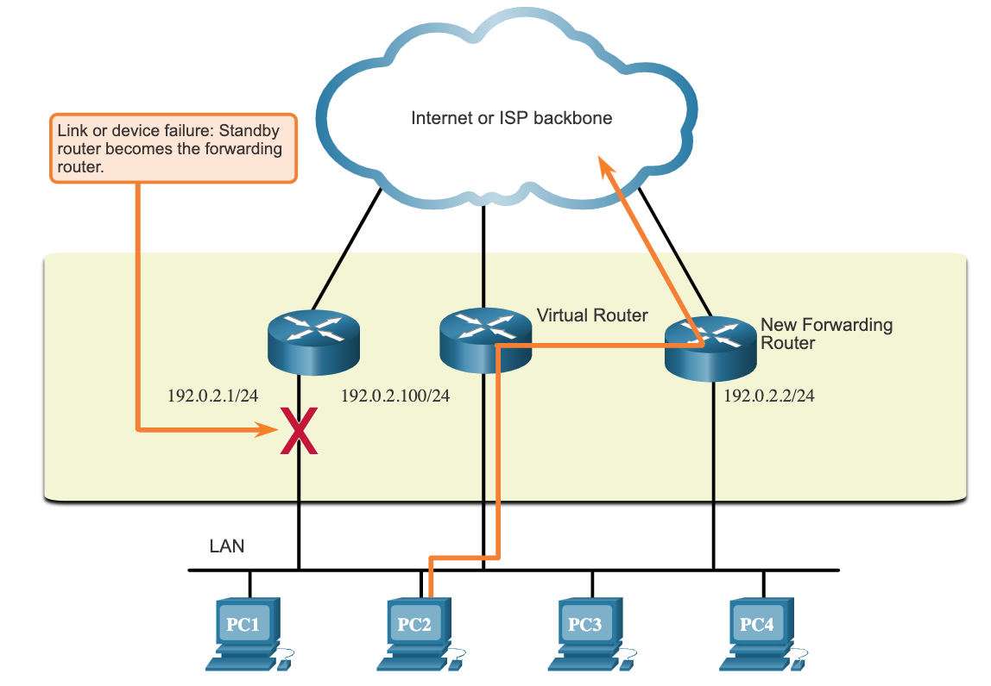
First Hop Redundancy Protocols Steps for Router Failover
When the active router fails, the redundancy protocol transitions the standby router to the new active router role, as shown in the figure. These are the steps that take place when the active router fails:
The standby router stops seeing Hello messages from the forwarding router.
The standby router assumes the role of the forwarding router.
Because the new forwarding router assumes both the IPv4 and MAC addresses of the virtual router, the host devices see no disruption in service.
Notes:
9 – FHRP Concepts
9.1 – First Hop Redundancy Protocols
9.1.3 – Steps for Router Failover

Slide 31
First Hop Redundancy Protocols FHRP Options
FHRP Options | Description
Hot Standby Router Protocol (HSRP) | HRSP is a Cisco-proprietary FHRP that is designed to allow for transparent failover of a first-hop IPv4 device. HSRP is used in a group of routers for selecting an active device and a standby device. The active device is the device that is used for routing packets; the standby device is the device that takes over when the active device fails, or when pre-set conditions are met.
HSRP for IPv6 | This is a Cisco-proprietary FHRP that provides the same functionality of HSRP, but in an IPv6 environment. An HSRP IPv6 group has a virtual MAC address derived from the HSRP group number and a virtual IPv6 link-local address derived from the HSRP virtual MAC address. Periodic router advertisements (RAs) are sent for the HSRP virtual IPv6 link-local address when the HSRP group is active. When the group becomes inactive, these RAs stop after a final RA is sent.
Virtual Router Redundancy Protocol version 2 (VRRPv2) | This is a non-proprietary election protocol that dynamically assigns responsibility for one or more virtual routers to the VRRP routers on an IPv4 LAN. This allows several routers on a multiaccess link to use the same virtual IPv4 address. In a VRRP configuration, one router is elected as the virtual router master, with the other routers acting as backups, in case the virtual router master fails.
VRRPv3 | This provides the capability to support IPv4 and IPv6 addresses. VRRPv3 works in multi-vendor environments and is more scalable than VRRPv2.
Gateway Load Balancing Protocol (GLBP) | This is a Cisco-proprietary FHRP that protects data traffic from a failed router or circuit, like HSRP and VRRP, while also allowing load balancing (also called load sharing) between a group of redundant routers.
GLBP for IPv6 | This is a Cisco-proprietary FHRP that provides the same functionality of GLBP, but in an IPv6 environment. GLBP for IPv6 provides automatic router backup for IPv6 hosts configured with a single default gateway on a LAN. Multiple first-hop routers on the LAN combine to offer a single virtual first-hop IPv6 router while sharing the IPv6 packet forwarding load.
ICMP Router Discovery Protocol (IRDP) | Specified in RFC 1256, IRDP is a legacy FHRP solution. IRDP allows IPv4 hosts to locate routers that provide IPv4 connectivity to other (nonlocal) IP networks.
Notes:
9 – FHRP Concepts
9.1 – First Hop Redundancy Protocols
9.1.4 – FHRP Options
9.1.5 – Check Your Understanding – First Hop Redundancy Protocols

Slide 32
4.5 HSRP
Notes:
9 – FHRP Concepts
9.2 – HSRP

Slide 33
HSRP HSRP Overview
Cisco provides HSRP and HSRP for IPv6 as a way to avoid losing outside network access if your default router fails. HSRP is a Cisco-proprietary FHRP that is designed to allow for transparent failover of a first-hop IP device.
HSRP ensures high network availability by providing first-hop routing redundancy for IP hosts on networks configured with an IP default gateway address. HSRP is used in a group of routers for selecting an active device and a standby device. In a group of device interfaces, the active device is the device that is used for routing packets; the standby device is the device that takes over when the active device fails, or when pre-set conditions are met. The function of the HSRP standby router is to monitor the operational status of the HSRP group and to quickly assume packet-forwarding responsibility if the active router fails.
Notes:
9 – FHRP Concepts
9.2 – HSRP
9.2.1 – HSRP Overview

Slide 34
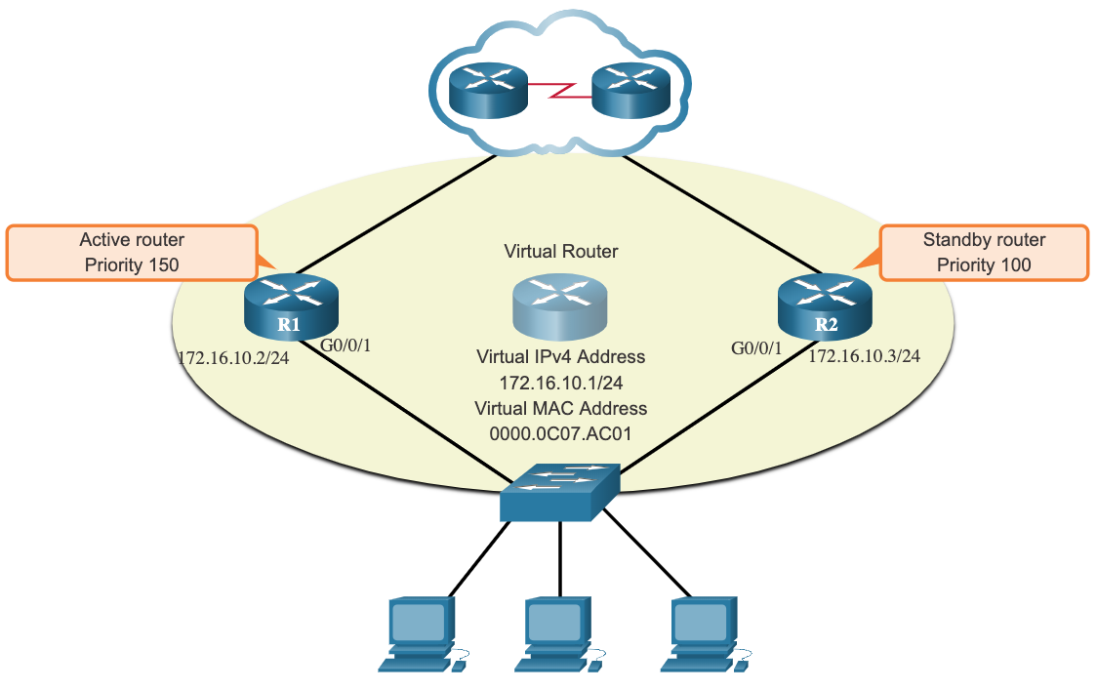
HSRP HSRP Priority and Preemption
The role of the active and standby routers is determined during the HSRP election process. By default, the router with the numerically highest IPv4 address is elected as the active router. However, it is always better to control how your network will operate under normal conditions rather than leaving it to chance.
HSRP priority can be used to determine the active router.
The router with the highest HSRP priority will become the active router.
By default, the HSRP priority is 100.
If the priorities are equal, the router with the numerically highest IPv4 address is elected as the active router.
To configure a router to be the active router, use the standby priority interface command. The range of the HSRP priority is 0 to 255.
Notes:
9 – FHRP Concepts
9.2 – HSRP
9.2.2 – HSRP Priority and Preemption

Slide 35
HSRP HSRP Priority and Preemption (Cont.)
By default, after a router becomes the active router, it will remain the active router even if another router comes online with a higher HSRP priority.
To force a new HSRP election process to take place when a higher priority router comes online, preemption must be enabled using the standby preempt interface command. Preemption is the ability of an HSRP router to trigger the re-election process. With preemption enabled, a router that comes online with a higher HSRP priority will assume the role of the active router.
Preemption only allows a router to become the active router if it has a higher priority. A router enabled for preemption, with equal priority but a higher IPv4 address will not preempt an active router. Refer to the topology in the figure.
Note: With preemption disabled, the router that boots up first will become the active router if there are no other routers online during the election process.
Notes:
9 – FHRP Concepts
9.2 – HSRP
9.2.2 – HSRP Priority and Preemption (Cont.)

Slide 36
HSRP HSRP States and Times
HSRP State | Description
Initial | This state is entered through a configuration change or when an interface first becomes available.
Learn | The router has not determined the virtual IP address and has not yet seen a hello message from the active router. In this state, the router waits to hear from the active router.
Listen | The router knows the virtual IP address, but the router is neither the active router nor the standby router. It listens for hello messages from those routers.
Speak | The router sends periodic hello messages and actively participates in the election of the active and/or standby router.
Standby | The router is a candidate to become the next active router and sends periodic hello messages.
The active and standby HSRP routers send hello packets to the HSRP group multicast address every 3 seconds by default. The standby router will become active if it does not receive a hello message from the active router after 10 seconds. You can lower these timer settings to speed up the failover or preemption. However, to avoid increased CPU usage and unnecessary standby state changes, do not set the hello timer below 1 second or the hold timer below 4 seconds.
Notes:
9 – FHRP Concepts
9.2 – HSRP
9.2.3 – HSRP States and Timers
9.2.4 – Check Your Understanding - HSRP

Slide 37
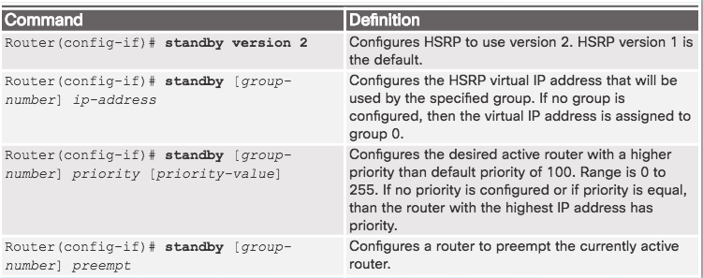
HSRP Configuration HSRP Configuration Commands
Step 1. Configure HSRP version 2.
Step 2. Configure the virtual IP address for the group.
Step 3. Configure the priority for the desired active router to be greater than 100.
Step 4. Configure the active router to preempt the standby router in cases where the active router comes online after the standby router.
Notes:
4.3 – First Hop Redundancy Protocols
4.3.3 – HSRP Configuration
4.3.3.1 – HSRP Configuration Commands

Slide 38
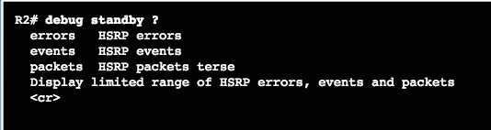
HSRP Troubleshooting HSRP Failure
Most issues will arise during one of the following HSRP functions:
Failing to successfully elect the active router that controls the virtual IP for the group
Failure of the standby router to successfully keep track of the active router
Failing to determine when control of the virtual IP for the group should be handed over to another router
Failure of end devices to successfully configure the virtual IP address as the default gateway
Notes:
4.3 – First Hop Redundancy Protocols
4.3.4 – HSRP Troubleshooting
4.3.4.1 – HSRP Failure

Slide 39
HSRP Troubleshooting Common HSRP Configuration Issues
Use the debug commands to detect common configuration issues:
HSRP routers are not connected to the same network segment. Although this could be a physical layer issue, it could also be a VLAN subinterface configuration issue.
HSRP routers are not configured with IPv4 addresses from the same subnet. HSRP hello packets are local. They are not routed beyond the network segment. Therefore, a standby router would not know when the active router fails.
HSRP routers are not configured with the same virtual IPv4 address. The virtual IPv4 address is the default gateway for end devices.
HSRP routers are not configured with the same HSRP group number. This will cause each router to assume the active role.
End devices are not configured with the correct default gateway address. Although not directly related to HSRP, configuring the DHCP server with one of the real IP addresses of the HSRP router would mean that end devices would only have connectivity to remote networks when that HSRP router is active.
Notes:
4.3 – First Hop Redundancy Protocols
4.3.4 – HSRP Troubleshooting
4.3.4.3 – Common HSRP Configuration Issues

